Slide 1
Module 2: Lesson 4:
Choose the best tools to build better solutions

Slide 2






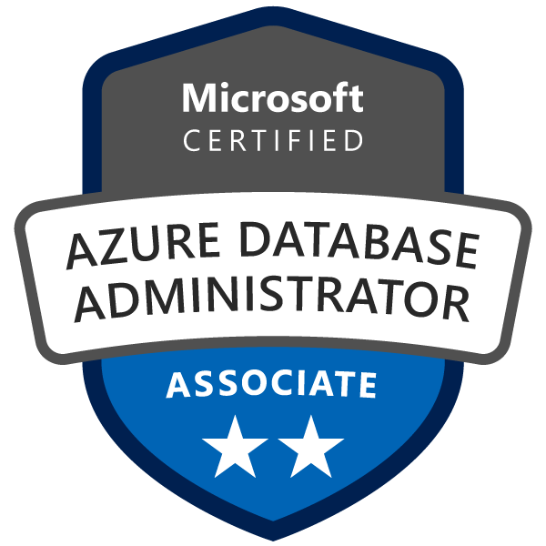

About The Presenter
Aaron Hughes
Senior Data and Analytics Consultant
17X Microsoft Certified
10 Years experience
Developed many SQL Server and Azure Modern Data Platform Solutions
LinkedIn
Azure Business Intelligence
Notes:
How Cloud Can Help DevOps Transformation

Slide 3


Lesson 4: Overview
This lesson will cover
Choose the software development process tools and services that best address specific business scenarios.
Notes:
How Cloud Can Help DevOps Transformation

Slide 4
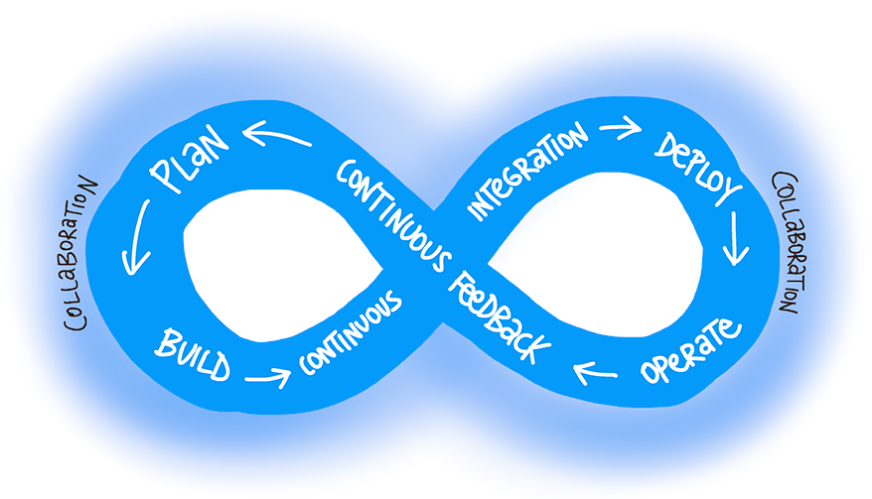
What is DevOps?
"DevOps is the union of people, process, and products to enable continuous delivery of value to end users."
– Donovan Brown, What is DevOps?

Slide 5
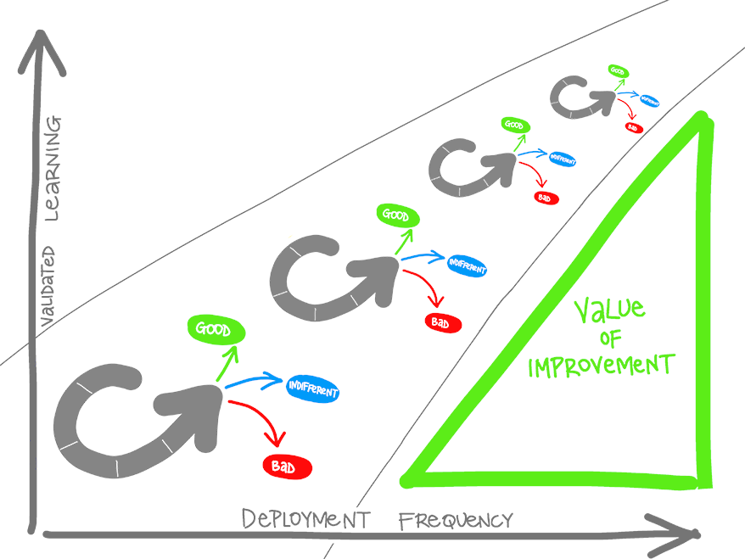
What is DevOps?
Understand your cycle time
Observe, Orient, Decide, Act (OODA) loop
Become data-informed
Strive for validated learning
Shorten your cycle time
Optimize validated learning

Slide 6

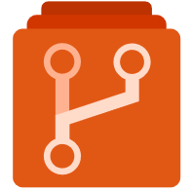


Understand your product options
Azure DevOps: development collaboration tools including pipelines, Kanban boards, and automated cloud-based load testing.
GitHub: software development hosting with version control, source code management, and bug/task management.
GitHub Actions for Azure: automate software workflow to build, test, and deploy from withing GitHub.
Azure DevTest Labs: quickly create environments in Azure while minimizing waste and controlling cost.
Notes:
Azure DevOps services provides development collaboration tools including pipelines, Git repositories, Kanban boards, and extensive automated and cloud-based load testing.
Azure DevTest Labs allows you to quickly create environments in Azure while minimizing waste and controlling cost.
GitHub is an American provides hosting for software development and version control using Git. It offers the distributed version control and source code management (SCM) functionality of Git, plus its own features. It provides access control and several collaboration features such as bug tracking, feature requests, task management, and wikis for every project.
GitHub Actions makes it easy to automate all your software workflows, now with world-class CI/CD. Build, test, and deploy your code right from GitHub. Make code reviews, branch management, and issue triaging work the way you want.

Slide 7
Azure DevOps Services
Azure Boards: Agile planning, work item tracking, visualization and reporting tool
Azure Pipelines: A language, platform and cloud agnostic CI/CD platform with support for containers or Kubernetes
Azure Repos: Provides cloud-hosted private git repos
Azure Artifacts: Provides integrated package management with support for Maven, npm, Python and NuGet package feeds from public or private sources
Azure Test Plans: Provides an integrated planned and exploratory testing solution
Notes:
Azure Boards is an agile project management suite that includes Kanban boards, reporting, and tracking ideas and work from high-level epics to work items and issues.
Azure Pipelines is a CI/CD pipeline automation tool.
Azure Repos is a centralized source-code repository where software development, DevOps engineering, and documentation professionals can publish their code for review and collaboration.
Azure Artifacts is a repository for hosting artifacts, such as compiled source code, which can be fed into testing or deployment pipeline steps.
Azure Test Plans is an automated test tool that can be used in a CI/CD pipeline to ensure quality before a software release.
Worth Mentioning for those working in more secure environments there is a DevOps Server install similar to the predecessor Team Foundation Server (TFS).

Slide 8

GitHub and GitHub Actions
Codespaces: Provide cloud-hosted collaborative development environments
Repos: Provide cloud-hosted and on-premises git repos for both public and private projects
Actions: Create automation workflows with environment variables and customized scripts
Artifacts: Ease integration with numerous existing packages and open-source repositories
Security: Review code and identity vulnerabilities early in the development cycle
Notes:
Arguably the world's most popular code repository for open-source software.
Git is a decentralized source-code management tool, and GitHub is a hosted version of Git that serves as the primary remote.
GitHub builds on top of Git to provide related services for coordinating work, reporting and discussing issues, providing documentation, and more. It offers the following functionality.

Slide 9
Azure DevTest Labs
Azure DevTest Labs provides an automated means of managing the process of building, setting up, and tearing down virtual machines (VMs) that contain builds of your software projects.
This way, developers and testers can perform tests across a variety of environments and builds.
And this capability isn't limited to VMs. Anything you can deploy in Azure via an ARM template can be provisioned through DevTest Labs.
Provisioning pre-created lab environments with their required configurations and tools already installed is a huge time saver for quality assurance professionals and developers.

Slide 10
Migrating or Integrating Existing Tools
Both Azure DevOps and GitHub can be integrated with a wide variety of existing work management tools:
Trello integration tooling is a free, flexible, and visual way to organize anything with anyone.
Solidify offers a tool for Jira to Azure DevOps migration.
Third party organizations offer commercial tooling to assist with migrating other work management tools like Aha, BugZilla, ClearQuest.
Azure Test Plans are used to track sprints and milestones. There is a Test & Feedback extension available in the Visual Studio Marketplace.
Other tools:
Apache JMeter is open-source software written in Java and designed to load test functional behavior and measure performance.
Pester is a tool that can be used to automate the testing of PowerShell code.
SoapUI provides another testing framework for SOAP and REST testing.

Slide 11
Decision Criteria
Do you need to automate and manage test-lab creation?
Are you building open-source software?
Regarding source-code management and DevOps tools, what level of granularity do you need for permissions?
Azure DevTest Labs. Among the three tools and services described, it's the only one that offers this functionality.
Although Azure DevOps can publish public code repositories, GitHub has long been the preferred host for open-source software
GitHub works on a simple model of read/write permissions to every feature. Meanwhile, Azure DevOps has a much more granular set of permissions that allow organizations to refine who is able to perform most operations across the entire toolset.
Notes:
Do you need to automate and manage test-lab creation?
If your aim is to automate the creation and management of a test lab environment, consider choosing Azure DevTest Labs. Among the three tools and services we've described, it's the only one that offers this functionality.
However, you can automate the provisioning of new labs as part of a toolchain by using Azure Pipelines or GitHub Actions.
Are you building open-source software?
Although Azure DevOps can publish public code repositories, GitHub has long been the preferred host for open-source software. If you're building open-source software, you would likely choose GitHub if for no other reasons than its visibility and general acceptance by the open-source development community.
The remaining decision criteria are specific to choosing between either Azure DevOps or GitHub.
Regarding source-code management and DevOps tools, what level of granularity do you need for permissions?
GitHub works on a simple model of read/write permissions to every feature. Meanwhile, Azure DevOps has a much more granular set of permissions that allow organizations to refine who is able to perform most operations across the entire toolset.

Slide 12
Decision Criteria
Regarding source-code management and DevOps tools, how sophisticated does your project management and reporting need to be?
Regarding source-code management and DevOps tools, how tightly do you need to integrate with third-party tools?
Although GitHub has work items, issues, and a Kanban board, project management and reporting is the area where Azure DevOps excels.
It's likely that most vendors that create DevOps tools create hooks or APIs that can be used by both Azure Pipelines and GitHub Actions.
Notes:
Regarding source-code management and DevOps tools, how sophisticated does your project management and reporting need to be?
Although GitHub has work items, issues, and a Kanban board, project management and reporting is the area where Azure DevOps excels. Azure DevOps is highly customizable, which allows an administrator to add custom fields to capture metadata and other information alongside each work item. By contrast, the GitHub Issues feature uses tags as its primary means of helping a team categorize issues.
Regarding source-code management and DevOps tools, how tightly do you need to integrate with third-party tools?
Although we make no specific recommendations about third-party tools, it's important for you to understand your organization's existing investments in tools and services and to evaluate how these dependencies might affect your choice. It's likely that most vendors that create DevOps tools create hooks or APIs that can be used by both Azure Pipelines and GitHub Actions. Even so, it's probably worth the effort to validate that assumption.

Slide 13
Which services should we choose?
The software development team at Tailwind Traders works on many different projects, both for internal and external usage. The team needs to give project sponsors and managers executive level reporting, including burndown charts, track progress against epics, and track custom information that's specific to Tailwind Traders in each work item and bug report.
As Tailwind Traders grows and hires contractors and outside vendors for short-term work, the upper management team wants to ensure that these individuals have access only to the information they need to do their work.

Slide 14
Which services should we choose?
First, does Tailwind Traders need to automate and manage test lab creation?
Second, is Tailwind Traders building open-source software?
Third, what level of granularity does Tailwind Traders need for permissions?
Fourth, does Tailwind Traders require a sophisticated project management and reporting solution?
Fifth, does Tailwind Traders require tight integration with any third-party DevOps tools?
Azure DevOps
Notes:
1 - No. So, in this scenario, Azure DevTest Labs is not a candidate, because it isn't intended for this specific use case.
2 - Though it's not stated specifically, Tailwind Traders is building internal and external systems, such as their e-commerce system, which isn't open source. So that isn't a consideration in this scenario.
3 - Earlier, we stated that Tailwind Traders will hire temporary employees and vendors for short-term work, which makes a granular permissions requirement an important consideration for upper management. Based on our description in the preceding unit, this feature would make Azure DevOps a leading candidate. By using Azure DevOps, Tailwind Traders administrators would also have a more robust set of options for controlling permissions across the entire portfolio of work.
4- Yes, robust project management and reporting features are one of the primary considerations. Here again, because of the amount of work-item customization and reporting the management team wants, Azure DevOps would likely be a good choice.
5 - Tool integration was not listed as a primary consideration for this scenario. As you learned in the preceding unit, most third-party DevOps tools integrate with both Azure DevOps and GitHub, which makes it likely that the team will find the tools it needs.

Slide 15
Which services should we choose?
Tailwind Traders hopes to publish an API that would allow third parties to integrate their own inventories of new and used items. This approach would allow Tailwind Traders to offer a wider variety of products directly from their e-commerce site.
Although the internal implementation of the API is closed source, Tailwind Traders wants to create a set of examples that call the API to perform various actions. The team needs a platform to share example code, collect feedback on the API, allow contributors to report issues, and build a community around feature requests.

Slide 16
Which services should we choose?
First, does Tailwind Traders need to automate and manage test lab creation?
Second, is Tailwind Traders building open-source software?
Third, what level of granularity does Tailwind Traders need for permissions?
Fourth, does Tailwind Traders require a sophisticated project management and reporting solution?
Fifth, does Tailwind Traders require tight integration with any third-party DevOps tools?
GitHub
Notes:
1 - No. In this scenario, Azure DevTest Labs is not a candidate because it isn't designed for this use case.
2 - Yes. As we noted in a previous unit, developers are used to seeing this kind of content available on GitHub. With GitHub, Tailwind Traders developers can publish their code, accept community contributions to improve the code examples, accept feedback and bug reports, and more. Because this scenario involves open-source code, GitHub is a leading candidate.
3 - Though it's not stated explicitly, the fact that Tailwind Traders will be accepting community contributions, issuing reports, and generally attempting to build a community of developers around their API examples, the company's permission needs are basic: users can either view only or view and write. This is another reason why GitHub would be a good candidate for this scenario.
4 - Again, because of the nature of this project, the team doesn't require a sophisticated project management and reporting solution. In this scenario, the strength of Azure DevOps Services isn't required.
5 - Tool integration wasn't listed as a primary consideration for this scenario and doesn't qualify or disqualify either tool.

Slide 17
Which services should we choose?
Tailwind Traders wants to be more methodical and careful when it pushes new versions of its e-commerce website to production. The company will expand its quality assurance (QA) team, and it will use the cloud to create and host virtual machines (VMs). Through this approach, it will create testing environments that match the production environment.
The management team has concerns around the costs of a more automated test environment. For instance, it wants to make sure that the QA professionals are not wasting time configuring the testing environment to match the production environment. The team wants to ensure that the VMs are destroyed when they're no longer in use. It wants to limit the number of VMs that each QA professional is allowed to spin up. Also, the team wants to ensure that each environment is configured correctly and consistent with the production environment.

Slide 18
Which services should we choose?
First, does Tailwind Traders need to automate and manage test lab creation?
Second, is Tailwind Traders building open-source software?
Third, what level of granularity does Tailwind Traders need for permissions?
Fourth, does Tailwind Traders require a sophisticated project management and reporting solution?
Fifth, does Tailwind Traders require tight integration with any third-party DevOps tools?
Azure DevTest Labs
Notes:
1 - Yes. This looks like a job for Azure DevTest Labs, because it can do everything that the team needs to accomplish in this scenario.
With this in mind there's not much point moving into the other questions

Slide 19




Prepare for The Exam (Q/A)
Which of the following choices would not be used to automate a CI/CD process?
Azure Pipelines
GitHub Actions
Azure Boards
Which service could help you manage the VMs that your developers and testers need to ensure that your new app works across various operating systems?
Azure Test Labs
Azure DevTest Labs
Azure Repos

Slide 20
Prepare for The Exam (Q/A)
Which service lacks features to assign individual developers tasks to work on?
Azure Boards
GitHub
Azure Pipelines

Slide 21

Summary
This lesson has covered
Choose the software development process tools and services that best address specific business scenarios.
Azure DevOps
GitHub and Git Actions
Azure DevTest Labs

Slide 22
Summary
Next Lesson:
Choose the best tools for managing/configuring Azure environment

